Slide 1

DEADLOCK

Slide 2
What is deadlock?
A set of blocked processes each holding
a resource and waiting to acquire a resource held by another job.
If two or more process are waiting on happening some event which never happen then we say these process come in deadlock that state is called Deadlock.
Deadlock is a common problem in multiprocessing systems, parallel computing and distributed systems

Slide 3
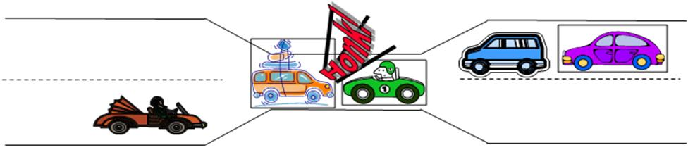
Deadlock EXAMPLE
EXAMPLE OF A BRIGDE CROSSING

Slide 4
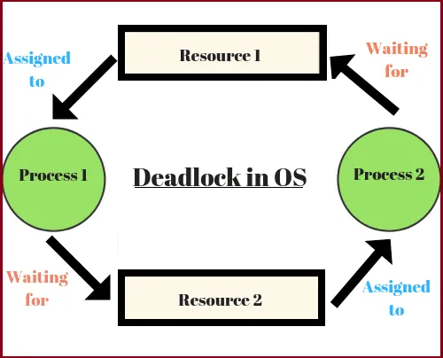
Example of deadlock Situation

Slide 5
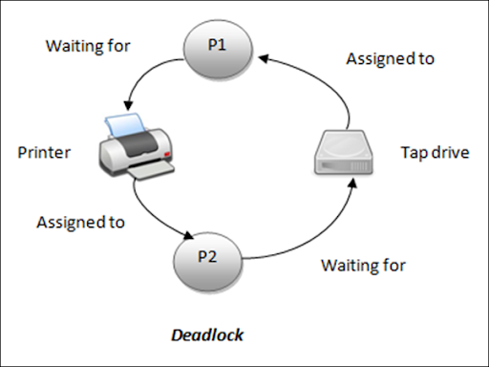

Slide 6
Deadlock Characterization/ Conditions
Necessary Conditions For Deadlock
Mutual EXCLUSION
Hold and Wait
No preemption
Circular wait
Note: All these 4 conditions must hold true for a deadlock to be present in a system

Slide 7
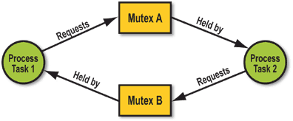
Example of mutual exclusion
Whatever the resources you are using, all the resources must be used by all the process by in a mutual exclusive manner
Note: Each process is use resource mutually and exclusively

Slide 8
Example of mutual exclusion
This problem can be resolved if there is resources are shared
Whatever the resources you are using, all the resources must be used by all the process by in a mutual exclusive manner
Note: Each process is use resource mutually and exclusively

Slide 9
Example of Hold and wait
Process A
Is waiting for
Resource 1
Is holding
Is holding
Is waiting for
Process B
Resource 2

Slide 10
Example of No preemption
Process A
Process B
Resource cannot be
Forcibly removed from
the process, until a process
is voluntarily release it.
Holding
Waiting
Resource

Slide 11
Example of Circular wait
Process A
Waiting
for
Waiting
for
Process D
Process B
Waiting
for
Waiting
for
Process C

Slide 12
Vertex
Process vertex
Resource Vertex
Single Instance
Multiple Instance
Resource allocation graph (RAG)
Edge
Assign Edge
Request Edge

Slide 13
Resource allocation graph IDENTITIES
Process
Resource
Resource Type with 2 instances
Resource Type with 4 instances
Request Edge
Pi
Rj
Assignment Edge
Pi
Rj

Slide 14
Resource allocation graph
If graph contains no cycles then no deadlock occurs.
If graph contains a cycle then,
If each resource type has a single instance, then deadlock
occurred.
If resource types have multiple instances, then deadlock
may occurs.

Slide 15
Resource allocation graph Example
With no cycles
R1
R3
requesting
assigned
P1
P2
P3
Note that there is no cycle
in the graph so that’s why there
is no chance of deadlock
R2
R4

Slide 16
Resource allocation graph with a deadlock
R1
R3
P1 => R1 => P2 => R3 => P3
=> R2 => P1
requesting
assigned
P1
P2
P3
P2 => R3 => P3 => R2 => P1
R2
R4

Slide 17
graph with a Cycle but no deadlock
P2
P1 => R1 => P3 => R2 =>
P1
assigned
R1
No deadlock
requesting
P3
Process P4 may release
its instance of resource
R2, then it can be
allocated to P3
P1
R2
P4

Slide 18
Methods of handling deadlocks
There are four methods for handling deadlocks,
Prevention
Avoidance
Detection & Recovery
Ignore the problem
Most operating system do this

Slide 19

DEADLOCK prevention
Do not allow the system to get into a deadlocked state.
Difference from avoidance is that here, the system itself
is build in such a way that there are no deadlocks.
Make sure at least one of the 4 deadlock conditions is
never satisfied or violated.
Mutual Exclusion
Hold and Wait
No Preemption
Circular Wait

Slide 20
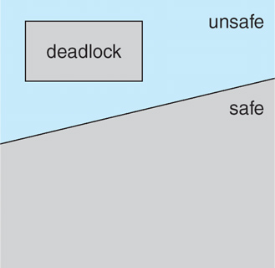
DEADLOCK avoidance
A deadlock avoidance algorithm ensures that the system is always
in a safe state. Therefore, no deadlock can occur
Safe and unsafe deadlock state
If system is in safe side,
then No deadlock.
If system is in unsafe
side, then deadlock
may occurred.
Note: All deadlocks are unsafe, but all unsafes are not deadlocks

Slide 21
Resource allocation graph algorithm
R1
P1
P2
Claim Edge
Remember that this algorithm
is for single instance of their
resources
R2
Resource Allocation Graph Algorithm for Deadlock Avoidance

Slide 22
Resource allocation graph algorithm
R1
P1
P2
P2 requests for R2
and that’s why it is given
to P2
R2
An unsafe state in a Resource Allocation Graph

Slide 23
DEADLOCK Detection
If deadlocks are not avoided, then another approach is to
detect when they have occurred and recover somehow.
P5
P5
R1
R3
R4
P1
P2
P3
P1
P2
P3
P4
P4
(B)
R1
R5
(A) = Resource allocation graph
(A)
(B) = Corresponding wait-for graph

Slide 24

DEADLOCK Recovery
Three basic approaches to recovery from deadlock:
Inform the system operator, and allow him/her to take
manual intervention
Process termination
Preempt resource

Slide 25
DEADLOCK Recovery
Process termination
Abort all deadlocked processes
Terminate processes one by one until the deadlock is broken
In which order should we choose to abort/terminate?
Priority of the process
How long process has been computed, and how much
longer to execution
Resources the process has used
How many more resources does the process need to
complete.
How many processes will need to be terminated

Slide 26
DEADLOCK Recovery
Resource preemption
Selecting a victim – which resources and processes are
preempted?
Rollback – return to some safe state, restart process from
that state
Starvation – we cannot always pick the same process as
a victim, some limit must be set

Slide 27

Question
A system is having 3 process each require 2 unit of resources ‘R’ . The minimum no.of unit of ‘R’ such that no deadlock is occur_______4____
Solution 3*2=6
P1
P2
P3
Min Req of resouse +1 can solve this situation
1
3 + 1= 4
1
1

Slide 28
Question
A system is having 3 process.P1 require 3 unit of resources ‘R’, P2 require 4 unit of resources ‘R’, P3require 5 unit of resources ‘R’.The minimum no.of unit of ‘R’ such that no deadlock is occur____10_______
Solution
P1
P2
P3
Min Req of resouse +1 can solve this situation
2
9 + 1= 10
3
4

Slide 29
Question
A system is having 3 process.P1 require 3 unit of resources ‘R’, P2 require 4 unit of resources ‘R’, P3require 5 unit of resources ‘R’.The maximum no.of unit of ‘R’ but still there is deadloack ____9_______
Solution
P1
P2
P3
Min Req of resouse
2
9
3
4

